Slide 1
Phenotypic Gender differences in Hepatitis C
Amanda Noska, MD, MPH
Infectious Diseases
April 5th, 2022

Slide 2
Disclosures
I have no financial disclosures.
I will not discuss off-label use of any pharmaceutical.

Slide 3
Outline
Pathophysiologic Differences in Immune function
Transmission Risk
Spontaneous Clearance of Hepatitis C
Liver Fibrosis and Cirrhosis
Hepatocellular Carcinoma

Slide 4
Immune Function- Chromosomal Differences
Sex- and X-linked differences in men and women exist, particularly at the level of the liver.
Estrogen receptors protect liver cells from inflammatory damage, apoptosis, and oxidative stress.
Men have fewer ER-α receptors, likely a direct cause of worse outcomes in men vs. women with HCV.
In a study on HBV, a single nucleotide polymorphism in ER-α was significantly associated with persistent HBV-infection.
Estrogen Receptors (ER-β) are highly expressed on T cells and B cells.
Ruggieri et al, 2018. Frontiers in Immunology.

Slide 5
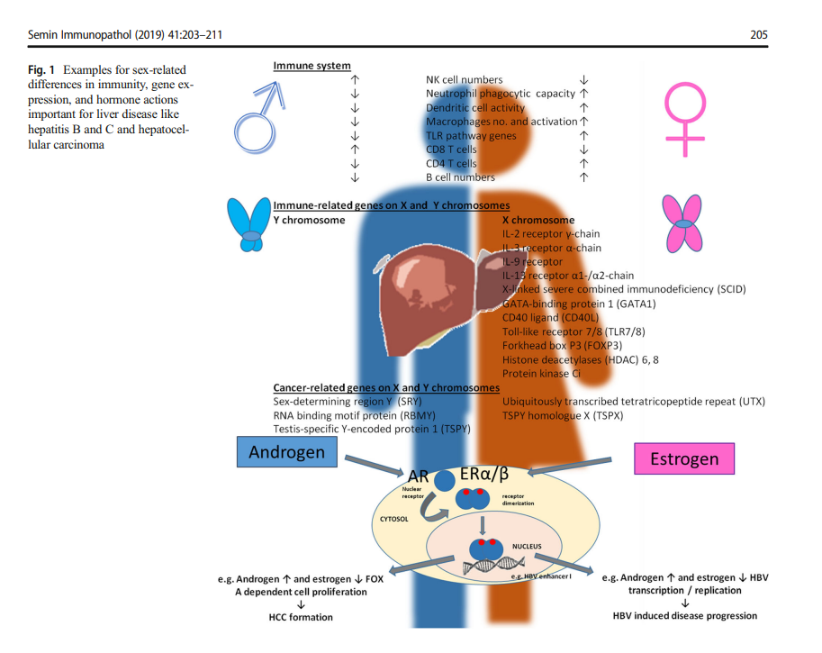
Buettner N & Thimme R. 2019. Seminars in Immunopathology.

Slide 6
Sex Hormones- Estrogen
Estrogens have anti-viral properties.
Estradiol protects the liver and is immunoprotective.
In low doses, estrogens:
Induce monocyte differentiation> high production of IL-4 and IFN-α, and active.
Activate Th1-type and cell-mediated immune responses.
In high doses, estrogens:
Inhibit activity on innate immune function & proinflammatory immune responses.
Activate Th2-type and humoral immune responses
At physiologic doses, estrogens:
Stimulate humoral response to viral infection by inducing higher levels of Abs and activating AB-producing cells.
Ruggieri et al, 2018. Frontiers in Immunology.
Burlone M et al. 2016. Eur J of Gastro and Hep.

Slide 7
Sex Hormones- Progesterone
Progesterone is immunosuppressive
Similar to androgen’s immune suppression on both innate and cell-mediated immune responses.
Suppresses Th1 response
Favors Th2 cytokine production
Inhibits cytotoxic T Cells
Modulates function of NK Cells
Ruggieri et al, 2018. Frontiers in Immunology.

Slide 8
Sex Hormones- Androgens
Androgens are also generally immunosuppressive
Testosterone has an immunosuppressive effect on the immune system
In rodents, may suppress the pro-inflammatory response by increasing anti-inflammatory cytokines such as IL-10, TGF-β
Androgen deficiency in men
Can induce increased levels of inflammatory cytokines (IL-1В, IL-2, and TNF)
Can increase the CD4+/CD8+ T cell ratio
Can trigger higher antibody titers
Inhibit the Th1 arm of the immune system
Consequently reduces production of IFN-γ
Explains enhanced susceptibility to viral infections in men vs. women
Ruggieri et al, 2018. Frontiers in Immunology.

Slide 9
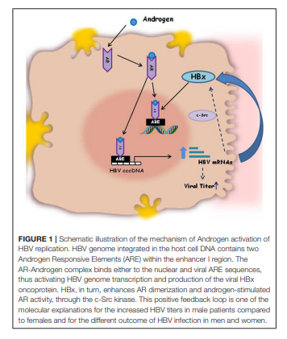
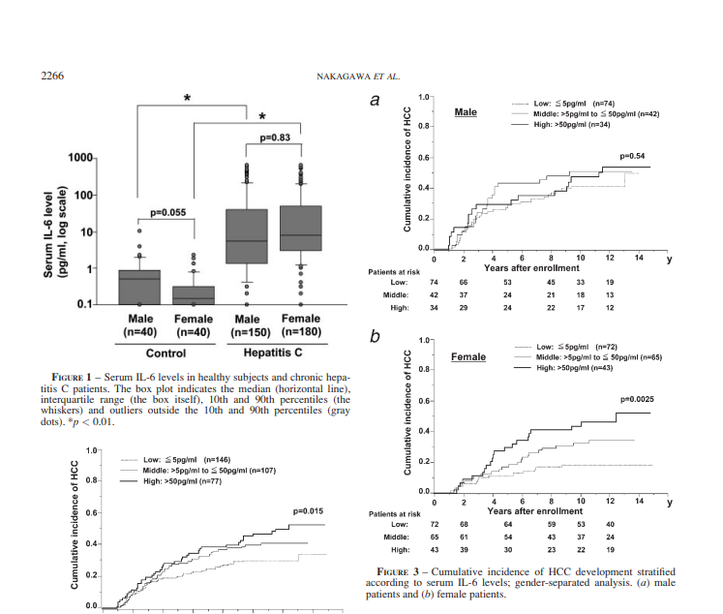
Ruggieri A, et al. 2018. Front Immunol.
Nakagawa H, et al. 2009. Int J Cancer.

Slide 10
Immune Function- Phenotypic Differences
Females are usually less susceptible to viral infections than males.
Females mount a more efficient, intense and prolonged immune response overall.
Innate
Humoral and
Cell-mediated
Pre-menopausal women response to vaccinations better than males.
Pre-menopausal women also have better treatment outcomes (or they did with PEG-IFN and ribavirin, more favorable HCV Gentoype profiles).
These phenotypic sex differences disappear in the post-menopausal period.
Ruggieri et al, 2018. Frontiers in Immunology.

Slide 11
Hepatitis C Transmission Drug Injection & Sexual Networks
Men may have higher lifetime drug-related risk behaviors:
Needle sharing
Length of drug use
Inject alone
Women, on the contrary, are more likely than men to:
Engage in receptive needle sharing/Be last on the needle
Have a partner with a history of IDU
Share drug works
To be injected by their male partner
To exchange sex for drugs or money
To have unprotected sex
Have a history of sexual trauma or forced sex in the context of drug use
To have difficulty negotiating safety during drug injection
Have significant overlap between drug injection networks and sexual networks than men
Butterfield M et al. 2003. Blood-Borne Infections and Persons with Mental Illness.
Iversen J et al. 2010. Int J of Drug Policy.
Folch C et al. 2013. Gac Sanit.
Viitanen P et al. 2010. J of Infect.
Leung J et al. 2019. J of Inf Dis.
Mehrabadi A et al. 2008. Women and Health.

Slide 12
Spontaneous Clearance of HCV
Females develop a more intense innate, humoral and cellular immune response to infection.
Higher CD4+ T cells
Increased cytokine production
Stronger antibody responses
Pre-menopausal women tend to clear HCV up to 40% of the time vs. 20-25% among men due to physiologic immune system differences.
In one study, young women were 29% less likely to be prescribed DAAs compared to men (Kanwal, 2016).
Ruggieri et al, 2018. Frontiers in Immunology.
Buettner N and Thimme R. 2019. Seminars in Immunopathology.
Kanwal F et al. 2016. Clin Infect Dis.

Slide 13
Liver Fibrosis and Cirrhosis
Males have higher rates or liver fibrosis and cirrhosis compared to pre-menopausal women.
Genetic and sex hormone differences
Higher rates of concomitant alcohol use disorders
Age-matched men have more severe fibrosis compared to women of reproductive age.
Ruggieri et al, 2018. Frontiers in Immunology.
Nakagawa H et al. 2009. Int J Cancer.
Buettner N & Thimme R. 2019. Seminars in Immunopathology.
Burlone M et al. 2016. Eur J of Gastro and Hep.

Slide 14
Liver Fibrosis and Cirrhosis
Pre-menopausal women tend to have lower circulating HCV RNA values. Women tend to control viral replication better than men.
Less necroinflammatory response
Less fibrosis progression
Post-menopausal women have increased rates of fibrosis compared to women of reproductive age (loss of protective effects of estrogen).
Raloxifene (an oral selective estrogen receptor modulator) improved SVR rates among post-menopausal women treated with PEG-IFN and Ribavirin.
Ruggieri et al, 2018. Frontiers in Immunology.
Nakagawa H et al. 2009. Int J Cancer.
Buettner N & Thimme R. 2019. Seminars in Immunopathology.
Burlone M et al. 2016. Eur J of Gastro and Hep.

Slide 15
Hepatocellular Carcinoma
70% of the genes in the liver may have characteristics of sex specificity.
Males are preferentially affected by HCC in a 2:1 to 7:1 ratio.
Intra-hepatic Cholangiocarcinoma is also more common among men.
On the contrary, females are more likely to have autoimmune liver disease.
The incidence of HCC among women rises in the post-menopausal period.
There are also different sex responses to HCC treatment:
Pre-menopausal women have lower mortality rates due to HCC and better outcomes from treatment than men or post-menopausal women.
Ruggieri et al, 2018. Frontiers in Immunology.
Nakagawa H et al. 2009. Int J Cancer.
Buettner N & Thimme R. 2019. Seminars in Immunopathology.

Slide 16
Hepatocellular Carcinoma
IL-6 is expressed in hepatocytes>
JAK-STAT response for cellular transcription &
MAPK response for cell survival and proliferation.
Estrogen inhibits IL-6.
Female patients with higher serum IL-6 levels had a higher risk of HCC (HR 1.61).
Higher IL-6 levels were not significantly associated with HCC in male patients.
Ruggieri et al, 2018. Frontiers in Immunology.
Nakagawa H et al. 2009. Int J Cancer.

Slide 17
Hepatocellular carcinoma
The X Chromosome has several X-linked microRNAs located within the estrogen response element.
Sex steroids relate to regeneration or homeostasis of organs:
Stem cell self-renewal is induced by estrogens
Cancer-associated fibroblasts differ by sex
Angiogenesis differs by sex
Inflammation, the immune system and metabolism all differ by sex.
Androgens contribute to HCC development by:
Acting as a tumor promoter by
Upregulation of beta-catenin/TCF signaling and
Via induction of DNA damage and oxidative stress.
Tamoxifen (anti-estrogen) therapy has been used in patients with HCC due to experimental data showing estrogen-dependent HCC growth.
Tamoxifen in patients with advanced HCC failed to show a survival benefit or an improvement in functional status.
Buettner N and Thimme R. 2019. Seminars in Immunopathology.

Slide 18
Questions or Comments?

Slide 19
References
Butterfield MI, et al. Five-Site Health and Risk Study Research Committee. Gender differences in hepatitis C infection and risks among persons with severe mental illness. Psychiatr Serv. 2003 Jun;54(6):848-53. doi: 10.1176/appi.ps.54.6.848. PMID: 12773599.
Leung J, et al. A Global Meta-analysis of the Prevalence of HIV, Hepatitis C Virus, and Hepatitis B Virus Among People Who Inject Drugs-Do Gender-Based Differences Vary by Country-Level Indicators? J Infect Dis. 2019 Jun 5;220(1):78-90. doi: 10.1093/infdis/jiz058. PMID: 30726973; PMCID: PMC6775227.
Wong E, Ricardo AC, Rosas SE, Lash JP, Franceschini N. Hepatitis C infection and chronic kidney disease among Hispanics/Latinos. Medicine (Baltimore). 2021 Dec 10;100(49):e28089. doi: 10.1097/MD.0000000000028089. PMID: 34889260; PMCID: PMC8663903.
Buettner N, Thimme R. Sexual dimorphism in hepatitis B and C and hepatocellular carcinoma. Semin Immunopathol. 2019 Mar;41(2):203-211. doi: 10.1007/s00281-018-0727-4. Epub 2018 Nov 29. PMID: 30498927.
Iversen J, Wand H, Gonnermann A, Maher L; collaboration of Australian Needle and Syringe Programs. Gender differences in hepatitis C antibody prevalence and risk behaviours amongst people who inject drugs in Australia 1998-2008. Int J Drug Policy. 2010 Nov;21(6):471-6. doi: 10.1016/j.drugpo.2010.04.004. Epub 2010 May 15. PMID: 20472417.
Al-Kindi S et al. Gender differences in Statin prescription. Clin Infect Dis. 2016. 63(7):993-4.
Platt L, Easterbrook P, Gower E, McDonald B, Sabin K, McGowan C, Yanny I, Razavi H, Vickerman P. Prevalence and burden of HCV co-infection in people living with HIV: a global systematic review and meta-analysis. Lancet Infect Dis. 2016 Jul;16(7):797-808. doi: 10.1016/S1473
Kanwal F, Kramer JR, El-Serag HB, Frayne S, Clark J, Cao Y, Taylor T, Smith D, White D, Asch SM. Race and Gender Differences in the Use of Direct Acting Antiviral Agents for Hepatitis C Virus. Clin Infect Dis. 2016 Aug 1;63(3):291-9. doi: 10.1093/cid/ciw249. Epub 2016 Apr 30. PMID: 27131869; PMCID: PMC6276931.-3099(15)00485-5. Epub 2016 Feb 25. PMID: 26922272.
Collazos J, Cartón JA, Asensi V. Gender differences in liver fibrosis and hepatitis C virus-related parameters in patients coinfected with human immunodeficiency virus. Curr HIV Res. 2011 Jul
Scheidell JD, Khan MR, Clifford LM, Dunne EM, Keen LD 2nd, Latimer WW. Gender differences in planning ability and hepatitis C virus among people who inject drugs. Addict Behav. 2015 Aug;47:33-7. doi: 10.1016/j.addbeh.2015.03.019. Epub 2015 Mar 26. PMID: 25863005; PMCID: PMC4417386.;9(5):339-45. doi: 10.2174/157016211797635982. PMID: 21827383.
Ruggieri A, Gagliardi MC, Anticoli S. Sex-Dependent Outcome of Hepatitis B and C Viruses Infections: Synergy of Sex Hormones and Immune Responses? Front Immunol. 2018 Oct 8;9:2302. doi: 10.3389/fimmu.2018.02302. PMID: 30349537; PMCID: PMC6186821.
Burlone ME, Pedrinelli AR, Giarda P, Minisini R, Pirisi M. Influence of age on sex-related differences among patients with hepatitis C. Eur J Gastroenterol Hepatol. 2016 Sep;28(9):1100-1. doi: 10.1097/MEG.0000000000000668. PMID: 27465347.
Nakagawa H, Maeda S, Yoshida H, Tateishi R, Masuzaki R, Ohki T, Hayakawa Y, Kinoshita H, Yamakado M, Kato N, Shiina S, Omata M. Serum IL-6 levels and the risk for hepatocarcinogenesis in chronic hepatitis C patients: an analysis based on gender differences
Folch C, Casabona J, Espelt A, Majó X, Meroño M, Gonzalez V, Brugal MT; REDAN Study Group. Gender differences in HIV risk behaviours among intravenous drug users in Catalonia, Spain. Gac Sanit. 2013 Jul-Aug;27(4):338-43. doi: 10.1016/j.gaceta.2013.02.006. Epub 2013 Apr 8. PMID: 23578527.. Int J Cancer. 2009 Nov 15;125(10):2264-9. doi: 10.1002/ijc.24720. PMID: 19585572.
Viitanen P, Vartiainen H, Aarnio J, von Gruenewaldt V, Hakamäki S, Lintonen T, Mattila AK, Wuolijoki T, Joukamaa M. Hepatitis A, B, C and HIV infections among Finnish female prisoners--young females a risk group. J Infect. 2011 Jan;62(1):59-66. doi: 10.1016/j.jinf.2010.10.011. Epub 2010 Nov 16. PMID: 21087630.

