Slide 1
Diagnosing Substance Use Disorders in Youth
Lauren Graber MD MPH
Brian Grahan MD PhD

Slide 2
Outline/ Objectives
Review key elements of adolescent brain development
Substance Use vs Use Disorder
Apply the DSM 5 Criteria for adolescents
Identify red flags / risk factors

Slide 3

Case:
15-year-old who first smoked marijuana at age 12, given by non-parent family member to help relax. 4 months ago, started smoking a couple of times daily. Denies trouble stopping, can go a week at a time without smoking. Denies cravings, but likes how it makes them feel. Denies mood changes when using.

Slide 4
Tensions
Family is not concerned
In order to get into an inpatient treatment program…
Stigma of diagnosis
Insurance coverage
Any drug use in teens is risky! Right?
It’s an opioid epidemic! We must do something!
Family is really concerned
Experimentation or Use Disorder?
Notes:
When considering a case like this – and like so many that we’ll go through today – there are several competing tensions that I want to name.

Slide 5
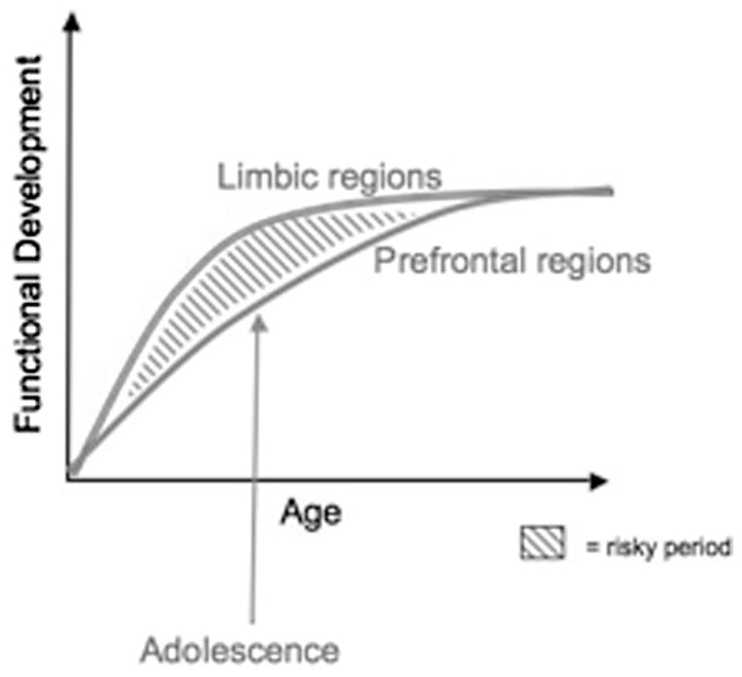
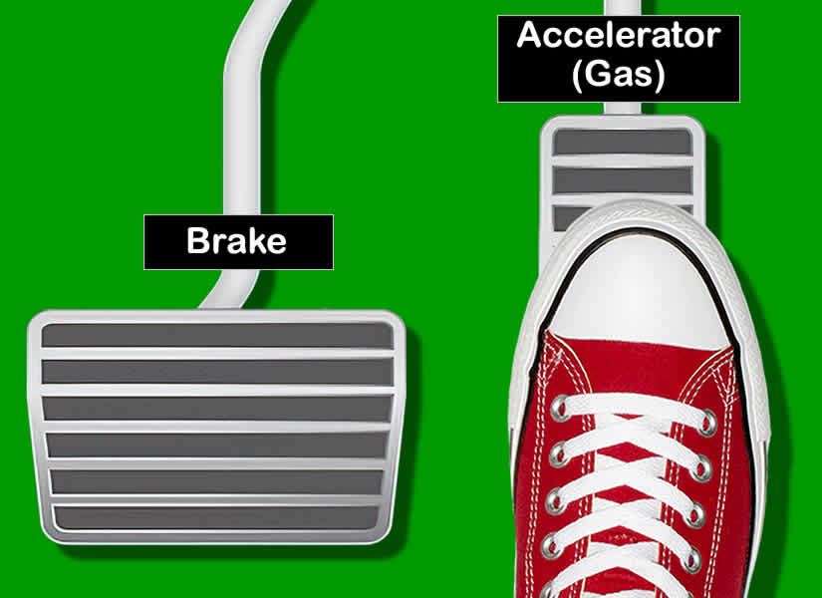
Adolescent Brain Development
Casey BJ et al. Developmental Rev. 2008
Notes:
As Dr. Polley reviewed last week. Adolescence is a unique time in brain development where the nucleus accumbens (in the limbic system, aka “pleasure center”) is fully developed but the prefrontal cortex is lagging. It’s a developmental drive to hit the gas pedal, and an underdeveloped brake.

Slide 6
Drug abuse & dependence peak with initiation at age 19
Addiction is a developmental disease!
Compton WM et al. Arch Gen Psychiatry. 2007
Notes:
Research does support that most individuals who have a substance use disorder initiate in adolescence. In this study asking adults with either drug abuse or dependence when they developed their use disorder, the peak for both was around age 19, and only rare onset after age 25. This is striking – and affirms in many ways that addiction is a developmental disease largely driven by the gap with the developing prefrontal cortex. Also, I want to acknowledge that when we are trying to diagnose a youth with SUD, we are in the eye of the storm – and it’s really hard to know what their course and direction will be.
Both drug abuse and drug dependence have a similar adolescent/early adult age at onset, peaking at about 19 years, with onsets after 25 years of age quite rare. The mean age at onset of drug abuse (19.9 years) was significantly (P = .04) younger than that of dependence (21.7 years).

Slide 7
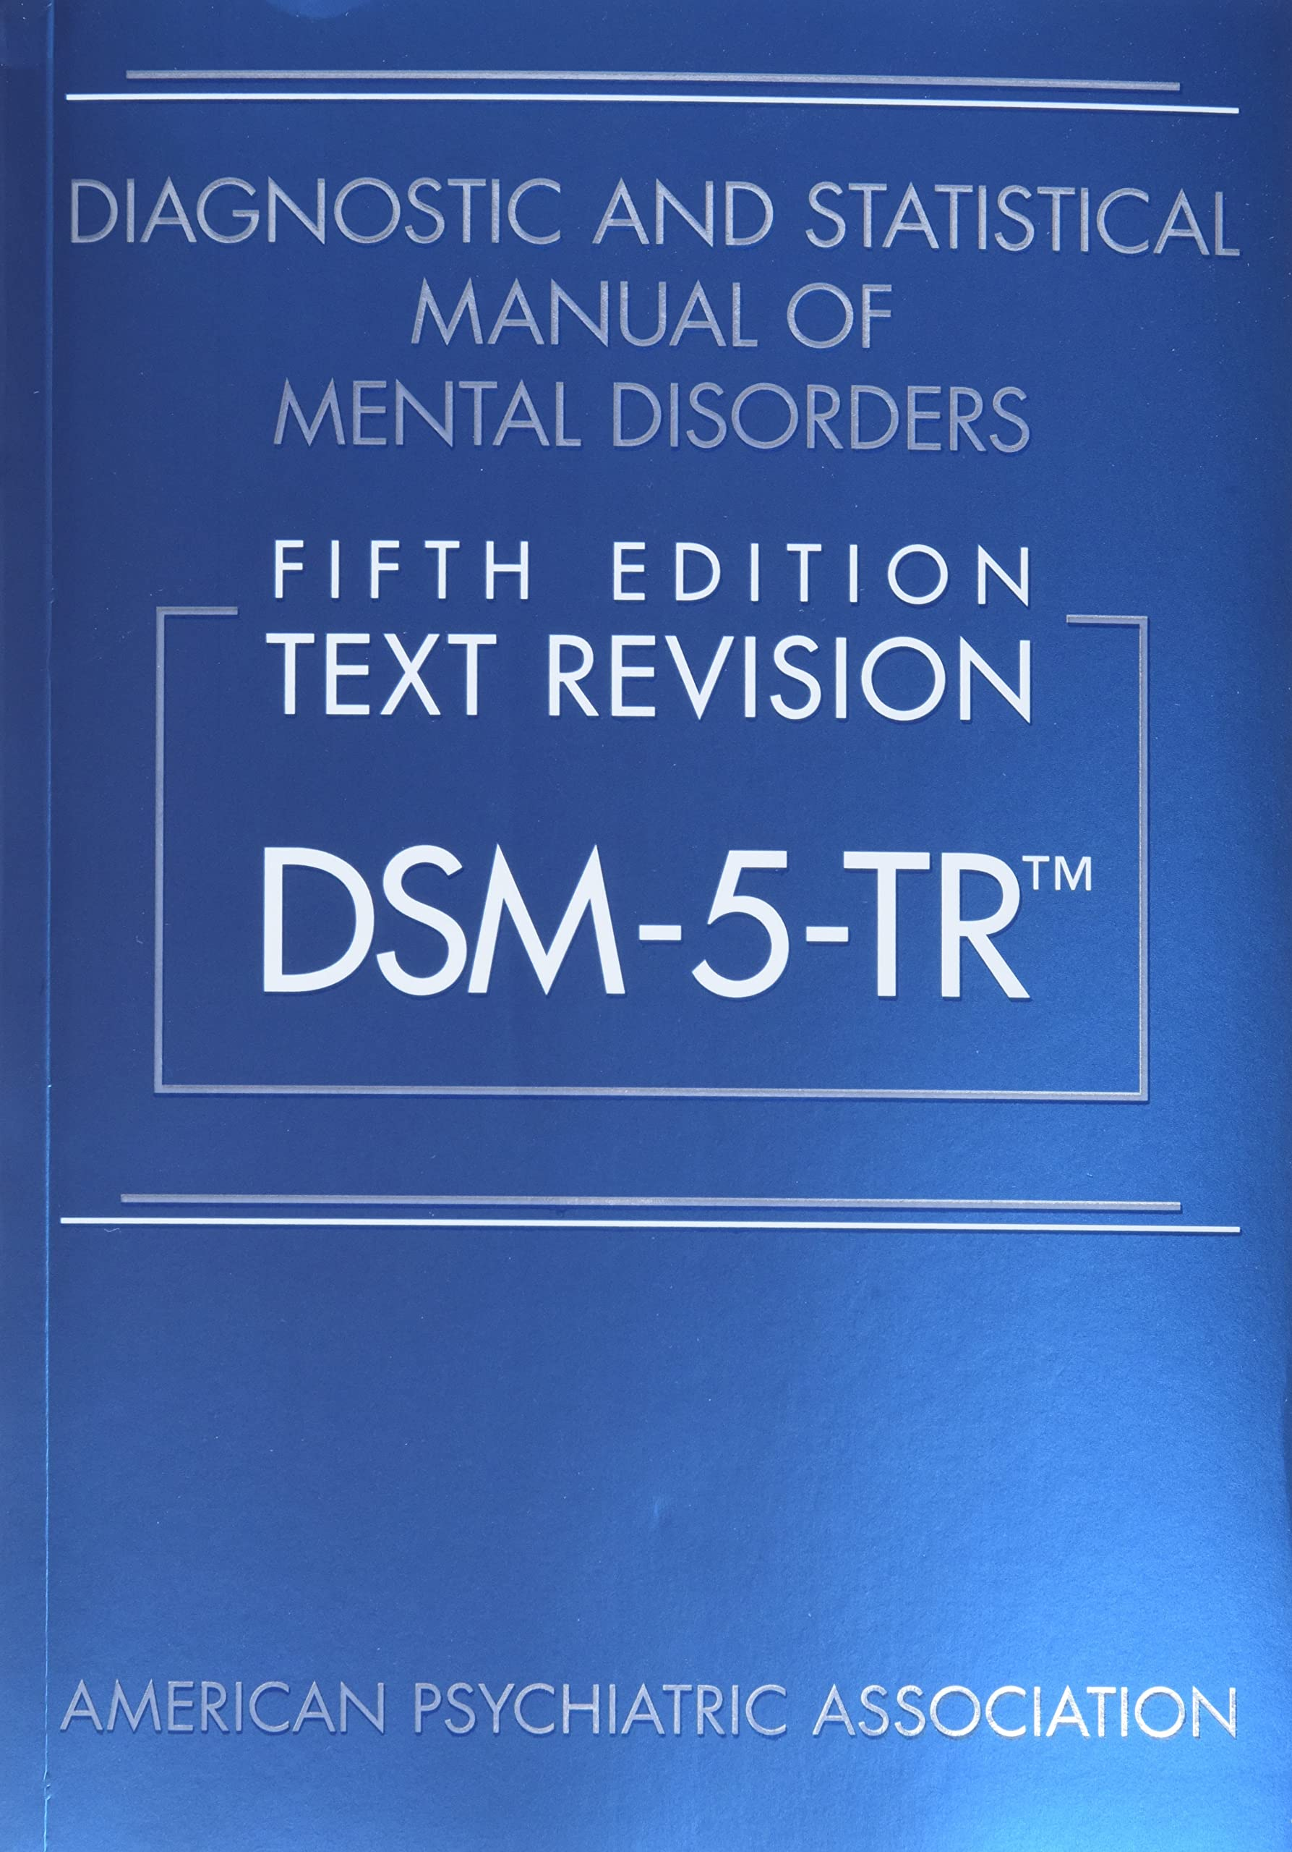
11 Criteria for Substance Use Disorders
2-3: Mild
4-5: Moderate
6 + : Severe
Notes:
So we’ve talked briefly about why the brain is primed for use disorders during adolescence. I’m now going to turn a bit towards the diagnostic criteria. The DSM is our guide for official diagnosis of substance use disorders. The big revision from DSM-IV to 5 occurred in 2013, as did the conceptual approach to SUDs. Moved from abuse & dependence distinctions to a spectrum of substance use disorders. These revisions were largely based on research with adults and today I want to not only step through the criteria and how they may apply to adolescents uniquely, but also share some of the ambiguity when applied within a developmental context.
There are 11 criteria for SUDs for all substances, including nicotine, cannabis, alcohol, opioids, stimulants, gambling. In the diagnosis, if a person has 2-3 criteria = mild, 4-5 = moderate and 6+ = severe. This inherently implies that each of these criteria have equal weight in the diagnosis, which I argue is not necessarily true for adolescents.

Slide 8
“A problematic pattern of substance use leading to clinically significant impairment or distress… occurring within a 12-month period”
Impaired Control
Social Impairment
Risky Use
Physical impairment
11 Criteria for Substance Use Disorders
4 Key Buckets of Criteria for SUD Diagnosis
Notes:
In the DSM, SUDs are defined as “…” as manifested by the 11 criteria. Ambiguity in “12 month period” – does that mean within a single year? Lasting a year? Different interpretations of that. “Clinically significant impairment or distress” is also contextual. The 11 criteria fall into 4 “buckets,” including …
Let’s go through the criteria together now – but first, another case

Slide 9

Case:
19-year-old comes in with family for help with opioids. Reports 5 months ago started smoking “blue pills,” started with 1 pill now and then but then after a couple of weeks was smoking daily. Planned to only smoke through December, but then couldn’t stop despite trying to cut down. Has not smoked in the past 5 weeks, but family concerned.

Slide 10
Impaired Control
1. Use in larger amounts or longer periods than intended
2. Unable to cut down or control use
3. Excessive time spent to obtain, use, or recover
4. Craving*
*Lack of consistency in youth about what this means: appetitive urges? Withdrawal? Lack of access?
Notes:
This case reveals much about the tensions facing this patient, but specifically showcases “impaired control”
He is using more fentanyl and for longer than intended
Unable to cut down or control use on the timeline he’d anticipated – other criteria include:
Excessive time spent to obtain, use or recover – spending large portion of days figuring out how to get a substance, or hungover the following day
Craving

Slide 11

Case:
16-year-old presents to clinic after opioid overdose treated in the ED. He was given buprenorphine then and was told to follow up in clinic. He smoked fentanyl with friends after school, but now changed schools. Knows that he has to stop for his family, especially his mom.

Slide 12
Social Impairment
5. Failure to fulfill major role obligations (work, home, school)
6. Persistent or recurrent use-related social or interpersonal problems
7. Important social, occupational, or recreational activities given up
Notes:
This case begins to reflect on the social role and impact of substance use, which for adolescents really means family and friends – and often guilt and shame towards family expectations. This bucket of criteria include:
“…” Who is defining the role? Classically that is not showing up to school because of intoxication/hangover. Getting intoxicated prior to going to school. But I want to challenge that a little more: Is it the family that defines that role? Or the teen? For example, adolescent smoking marijuana. Are there other pressures that the kid is experiencing that are impacting their “role” – what is that within their unique context.
“…” Conflict in families causing distress (but distress to who)
Change in activities, change in goals (but again, who’s goals? Giving up family movie night in favor of being with friends may be developmentally appropriate, or no longer going to mosque or church

Slide 13
Case:
16-year-old comes to clinic after disclosing to PCP that she overdosed 2x with opioids. Reports that everyone in her school uses drugs & that she was the last one to overdose. Started using opioids at age 10-11 when she and a cousin stole percocets to get “blissed out.”
Shares that she is now in a relationship with a man who is in a gang and he questioned her when she declined drugs before. He’s told her that “he doesn’t want her to change”
Notes:
Another case!

Slide 14

Risky Use
8. Recurrent physically hazardous use*
9. Use despite persistent physical or mental harm from drug
* Developmentally bound!
Notes:
This case is important in thinking about what is risky use and remembering that risk may be relative. Risk taking a hallmark of adolescence – partially due to limited understanding of consequences (infallibility), or timing of consequences (smoking, alcohol).
“…” What does this mean for adolescents? Hazardous use is more common in adults because more access to cars. Also hazardous use compared to what? (driving, swimming, having sex)
“…” physical or mental harm – for an adolescent to recognize this requires insight that they sometimes can have. (blackouts, liver disease, depression, anxiety, psychosis)

Slide 15

Case:
20-year-old brought into the hospital after a car accident when under the influence. Reports to smoke meth daily x 3 years & now also percocets daily for the past 6 months. He’s sweating, vomiting, and restless.
You give him buprenorphine and then a couple of hours later he starts vomiting much more. He refuses any more buprenorphine.

Slide 16
Physical Dependence
10. Tolerance, either
- need for increased amounts to achieve intoxication
- diminished effect when taking same amount
11. Withdrawal, either
- withdrawal syndrome
- substance taken to avoid or relieve withdrawal
Notes:
Physical dependence is often important to tease out – while previously felt to be a sign of more severe “dependence,” this doesn’t hold true for adolescents.
10. Tolerance is either needing more or having less effect when taking the same amount. Research finds that tolerance actually develops quite early in the progression of SUDs and it can by mild and without distress
11. Withdrawal, however, can be more indicative of problematic use – and I find it’s really important to ask specifically about withdrawal symptoms as kids don’t know what “withdrawal” means. There is the option for overreporting if confusion with hangover

Slide 17
Limitations of DSM-5 criteria
Diagnoses are more prevalent using DSM-5 criteria compared with DSM-IV among pediatric patients
Nicotine 4.0% vs 2.7%
Alcohol 4.6% vs 3.8%
Cannabis 10.7% vs 8.2%
Threshold for diagnosis appears low for adolescents
Potential harms
Kelly SM et al. Drug Alcohol Depend. 2014
Notes:
Threshold for diagnosis appears low for adolescents
Some are developmentally normative
Potential for over-endorsing
Potential harm:
Labeling a youth with a stigmatizing diagnosis
Reflecting intermittent use or regular use?
Notably, with the changes in DSM criteria, diagnoses of nicotine, alcohol, and cannabis are more prevalent than previously

Slide 18
Limitations of DSM-5 criteria
Are some criteria more indicative
of use disorder than others?
Criteria for Alcohol Use
Disorder:
*Gender differences in likelihood to report symptoms
Lower value
Social problems
Role impairment
Higher value
Hazardous Use*
Physical/Psych problems*
Withdrawal
Tolerance
Quit or Cut Down
Martin et al. Journal of Abnormal Psychology. 2006
Notes:
And as I’ve implied earlier as we looked at the various criteria, it does appear that with adolescents, some criteria do appear to hold stronger than others. This was a study that really looked at the predictive value of different criteria specifically for adolescents and alcohol use. Those who endorsed social problems, tolerance, and role impairment were less likely to have increased risk of alcohol dependence. Whereas those with withdrawal, attempts to quit of cut down, physical or psychological problems, and hazardous use had increased predictive values. Notably, girls were more likely to report physical/psych problems, and boys hazardous use (and of course, thinking about our prior discussions about the utility of hazardous use)

Slide 19
Limitations of DSM-5 criteria
Are some criteria more indicative of use disorder than others?
Criteria for Cannabis Use Disorder:
*Gender differences in likelihood to report symptoms
Lower value
Role impairment
Higher value
Quit or Cut Down
Physical/Psych problems*
Tolerance
Social problems
Time spent
Martin et al. Journal of Abnormal Psychology. 2006
Notes:
For cannabis, the predictive values were a little different. Noting that the most predictive were physical/psychologic problems or prior attempts to quit or cut down.
In the eye of the storm (which is adolescence), we cannot predict the future – will this young adult develop a substance use disorder?

Slide 20
Risk Factors for Use Disorders
High risk screen in patient <14 years old
Adverse Childhood Experiences
Co-occurring Mental Illness
Family history of SUD
Notes:
In the eye of the storm (which is adolescence), we cannot predict the future – will this young adult develop a substance use disorder?
Now that we’ve reflected on brain development, the DSM criteria and their applications to adolescents, I thought it would be helpful to outline some specific risk factors and red flags with adolescents.

Slide 21
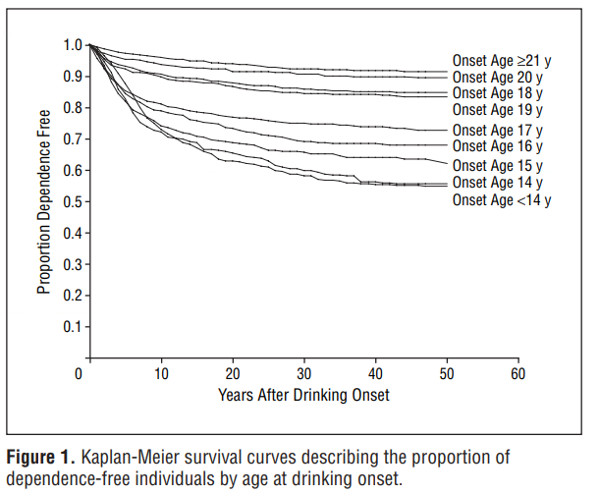
High Risk Screen <14 year old
Alcohol Use
For those who started drinking
  Before age 14, 47% experienced alcohol dependence in their lifetime
  Older than 21, 9%.
Hingson RW et al. Archives of Pediatrics & Adol Medicine. 2006
Notes:
Why are we concerned about youth who start using prior to age 14? Mostly based on research with alcohol, such as this one, that show that the lifetime risk of developing a use disorder is much higher the younger a person is at initiation. 47% of those who initiate drinking prior to 14 develop dependence compared to 9% of those who start at older than 21

Slide 22
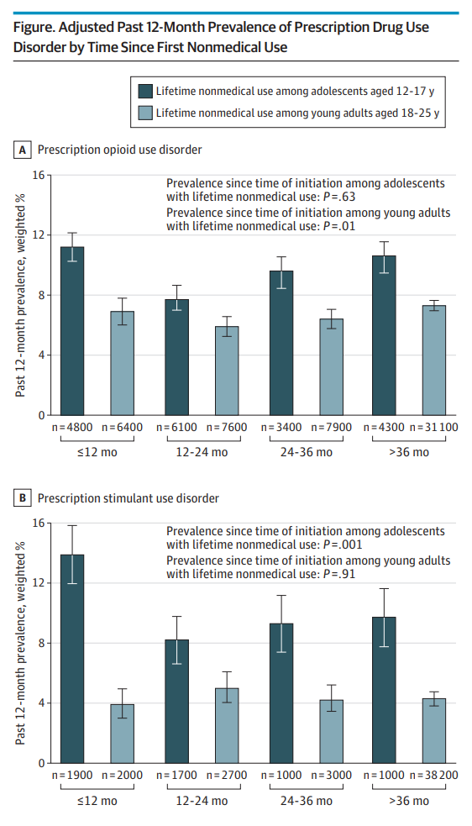
High Risk Screen <14 year old
Appears similar for other substances, too
Volkow N et al. JAMA Pediatrics. 2021
Notes:
Trends suggest that earlier initiation of nicotine and cannabis also have a higher risk of developing a use disorder – harder to estimate for cocaine, meth or heroin/fentanyl use as historically those numbers for youth age 12-17 have been so low. This more recent study looked at age of initiation of prescription medications for nonmedical reasons. The dark bars are adolsecents aged 12-17 and the lighter bars for young adults ages 18-25 (notably both groups are still developing their brains). This data suggests that no matter the time since initial use, adolescents who start earlier have a higher prevalence of OUD that young adults.

Slide 23
High Risk Screen <14 year old
Appears similar for other substances, too
Volkow N et al. JAMA Pediatrics. 2021
Notes:
This same pattern was also seen with nonmedical use of prescription stimulants

Slide 24
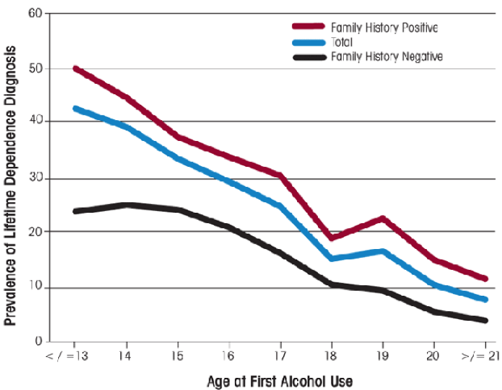
Family History of SUD
NESARC, 2001-02
Notes:
Another risk factor is family history. This study about alcohol use shows that adolescents with a family history (the red line) have significantly higher prevalence of developing a diagnosis of dependence. Certainly, research suggests that genetic risk factors in addition to home/neighborhood involvement can place individuals at higher risk.

Slide 25
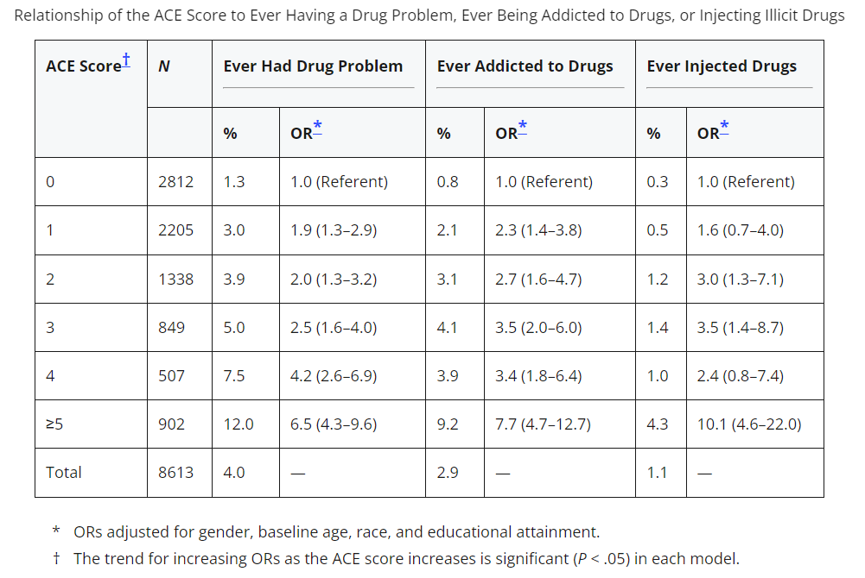
Adverse Childhood Experiences
Dube et al. Pediatrics. 2003
Notes:
ACES are another risk factors. In this original ACES study from 2003, the cumulative effect of ACES led to a higher odds ratio of having a drug problem, addiction to drugs or drug injection. Again, this was asking adults retrospectively.

Slide 26
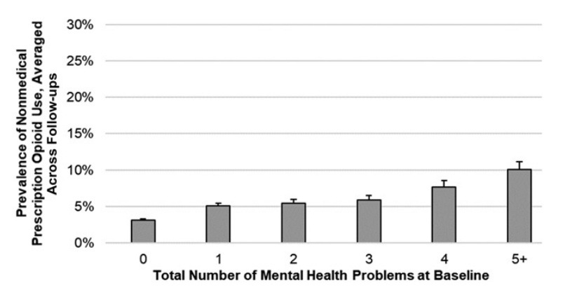
Co-occurring mental illness
Adjusted Odds Ratios (p<0.04)
1.59 2.05 3.26 3.63 4.07
Mean prevalence of past 6-month nonmedical prescription opioid use across follow ups, by baseline cumulative mental health problem indices
Junhan Cho et al. Pediatrics. 2021
Notes:
The last of the 4 risk factors I’m going to highlight today is co-occurring mental illness; which highlights some of the theories around “self medicating”
Sum of positive screen results at the clinical level for major depression, generalized anxiety disorder, panic disorder, social phobia, obsessive-compulsive disorder, and hypomania or mania (range 0–6).
Adolescents that have increased mental health problems have a higher odds of using prescription opioids – this study does not actually connect substance use disorder, although clearly that is the concern.

Slide 27

Case:
16-year-old presents to the ED after a car accident where both she & her boyfriend were intoxicated. She started drinking at age 13. She has now had 4 ED or hospital stays in the last 5 months related to alcohol use and 3 that involved police. In 3 of these visits, she was evaluated by psychology due to suicidal ideation while intoxicated.

Slide 28
SUD Criteria (DSM-5)
for adults
Category | Criteria
Impaired control | Use in larger amounts or longer periods than intended Unable to cut down or control use Excessive time spent to obtain, use, or recover Craving
Social impairment | Failure to fulfill major role obligations (work, home, school) Persistent or recurrent use-related social or interpersonal problems Important social, occupational, or recreational activities given up
Risky use | Recurrent physically hazardous use Use despite persistent physical or mental harm from drug
Physical dependence | Tolerance Withdrawal

Slide 29
SUD Criteria (DSM-5)
for youth
Category | Criteria
Impaired control | Use in larger amounts or longer periods than intended Unable to cut down or control use Excessive time spent to obtain, use, or recover Craving
Social impairment | Failure to fulfill major role obligations (work, home, school) Persistent or recurrent use-related social or interpersonal problems Important social, occupational, or recreational activities given up
Risky use | Recurrent physically hazardous use Use despite persistent physical or mental harm from drug
Physical dependence | Tolerance Withdrawal
Requires developmental interpretation
  Risk factors
    Family history of use disorders
    Early drug exposure
    Comorbid mental illness
    Adverse childhood events

Slide 30
Summary
Addiction is a developmental disease
Consider DSM 5 Criteria with a developmental lens & context
Red flags: age <14, family history, +ACES, co-occurring mental illness
Contemplate use vs use disorder

Slide 31
Thank you!
Lauren Graber MD MPH lauren.graber@hcmed.org
Brian Grahan MD PhD brian.grahan@hcmed.org

Slide 32
Casey BJ, Getz S, Galvan A. (2008). The adolescent brain. Development Review, 28(1): 62-77.
Dube SR, Felitti VJ, Dong M, Chapman DP, Giles WH, Anda RF. Childhood abuse, neglect, and household dysfunction and the risk of illicit drug use: the adverse childhood experiences study. Pediatrics. 2003 Mar;111(3):564-72. doi: 10.1542/peds.111.3.564. PMID: 12612237
Hingson RW, Heeren T, Winter MR. (2006). Age at drinking onset and alcohol dependence: Age at onset, duration, and severity. Archives of Pediatrics and Adolescent Medicine, 160(7): 739-746.
Junhan Cho, Lorraine I. Kelley-Quon, Jessica L. Barrington-Trimis, Afton Kechter, Sarah Axeen, Adam M. Leventhal; Behavioral Health Risk Factors for Nonmedical Prescription Opioid Use in Adolescence. Pediatrics September 2021; 148 (3): e2021051451. 10.1542/peds.2021-051451
Kelly et al. Concordance between DSM 5 and DSMIV nicotine, alcohol and cannabis use disorder diagnoses among pediatric patients Drug Alcohol Depend 2014 July 1;140:213-216
Martin, CS; Chung, T, Kirisci L; Langenbucher, JW. Item Response Theory Analysis of Diagnostic Criteria for Alcohol and Cannabis Use Disorders in Adolescents: implications for DSM-V. Journal of Abnormal Psychology. 2006; 115(4):807-814.
Volkow, ND; Han, B; Einstein, E, Compton, WM. Prevalence of Substance Use Disorders by Time Since First Substance Use Among Young People in the US. JAMA Pediatrics June 2021; 175(6):640-643.
Wilson M. Compton, MD, MPE; Yonette F. Thomas, PhD; Frederick S. Stinson, PhD; et al Prevalence, Correlates, Disability, and Comorbidity of DSM-IV Drug Abuse and Dependence in the United States: Results From the National Epidemiologic Survey on Alcohol and Related Conditions. Arch Gen Psychiatry. 2007;64(5):566-576. doi:10.1001/archpsyc.64.5.566
Winters, “Commentary on O’Brien: Substance Use Disorders in DSM5 when Applied to Adolescents” Addiction. 2011 May ; 106(5): 882–897. doi:10.1111/j.1360-0443.2010.03334.x.
References

